Slide 1
Group J Pitch Presentation
Tom Goncin
Bright Ugbur
Tobi Akinmade
Ogunrinde Gbolabo

Slide 2

Ever needed a handyman and didn’t know who to trust?

Slide 3

Good tradespeople exist — but the system works against them.
“The problem isn’t skill.
It’s visibility and trust.”

Slide 4
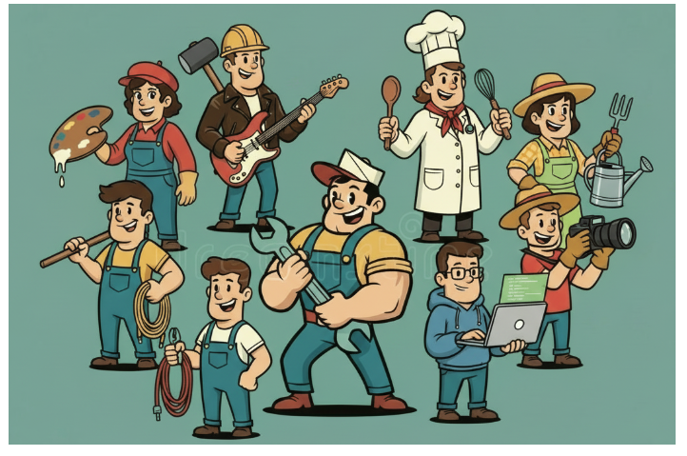
Handyman’s Helper
Finding trusted local help — without the stress

Slide 5
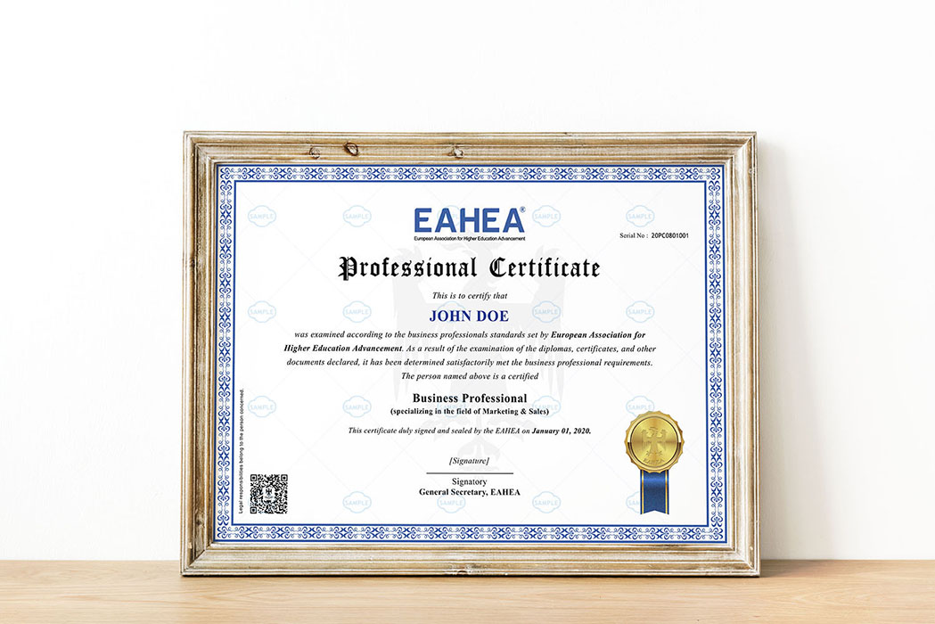
Built on Trust & Verification
Providers upload credentials
Documents are verified
Verified badge shown on profile
Clients see proof before hiring

Slide 6

Show the Work. Prove the Skill.
Photos & videos of past projects
Client-approved highlights
Ratings & reviews

Slide 7
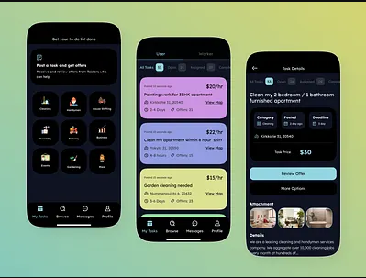
Built-In Job Bidding (Key Feature)
Not just lowest price — best value wins

Slide 8
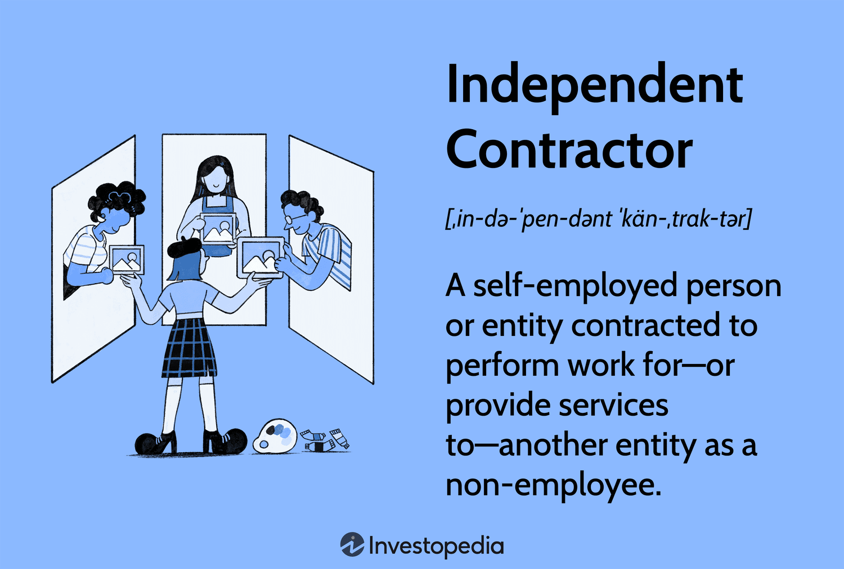
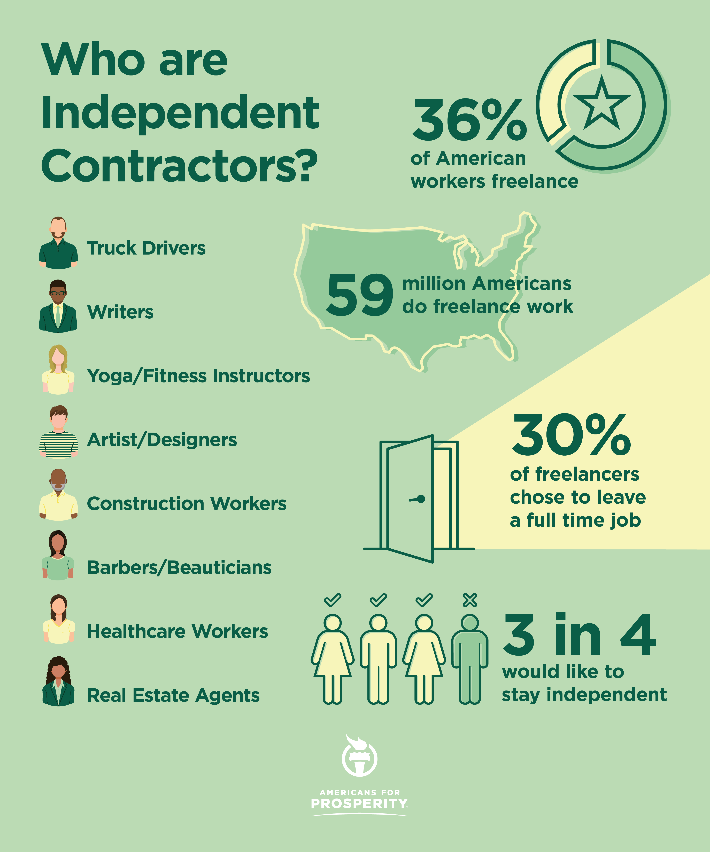
Who Uses Handyman’s Helper?
Clients
Service Providers
Homeowners
Renters
Property Managers
Tradespeople
Renovators
Small Companies

Slide 9

Why it Matters
Less Risk for Homeowners
Fair Access to work
Stronger Local Communities
Handyman’s Helper — Built on Skill, Trust, and Transparency

